Slide 1
RIT Business Analytics
Spring 2022 Competition
Team MaTron
Matt Hochman, Tron Schell

Slide 2
Problem Description

Slide 3
Problem Description
Small Capital Bank (SCB) is a novel loan company.
We have been tasked to advise SCB on their current loan decision making process and loan portfolio health.
Notes:
Small Capital Bank (SCB) is a novel loan company headquartered in New York City. SCB loans
are made available to almost anyone in small amounts, and can help those who otherwise
would be unable to secure a loan from a more conventional bank.
Specifically, we have been asked to advise SCB on three main objectives.

Slide 4
Problem Description
Decision Boundary (Model)
Mitigation of Bias
Portfolio Performance
Notes:
SCB wants a decision boundary (a model) for accepting or rejecting future loan applicants. They wish to use this new acceptance process to maximize profitability.
SCB is concerned about bias present within its current loan acceptance rules. If there is bias present, SCB wants to know how to mitigate it.
SCB wants to know how well their 2017-2018 loan portfolio is performing in regards to profitability. And they also want to know what factors affect the profitability of a loan.

Slide 5
Data Preprocessing

Slide 6
Datasets
Dataset 1
Loan portfolio (2017-2018)
Used to build our model
Dataset 2
Current loan applications
Where our model will be applied

Slide 7


Datasets (cont.)
There were features in Dataset 1 that were not contained in the Dataset 2 and needed to be removed to avoid what is known as “Data Leakage”.
Dataset 1
Dataset 2

Slide 8

Datasets (cont.)
Because we are predicting if a person will/will not default, this is called a classification problem.
Unbalanced classification problem

Slide 9
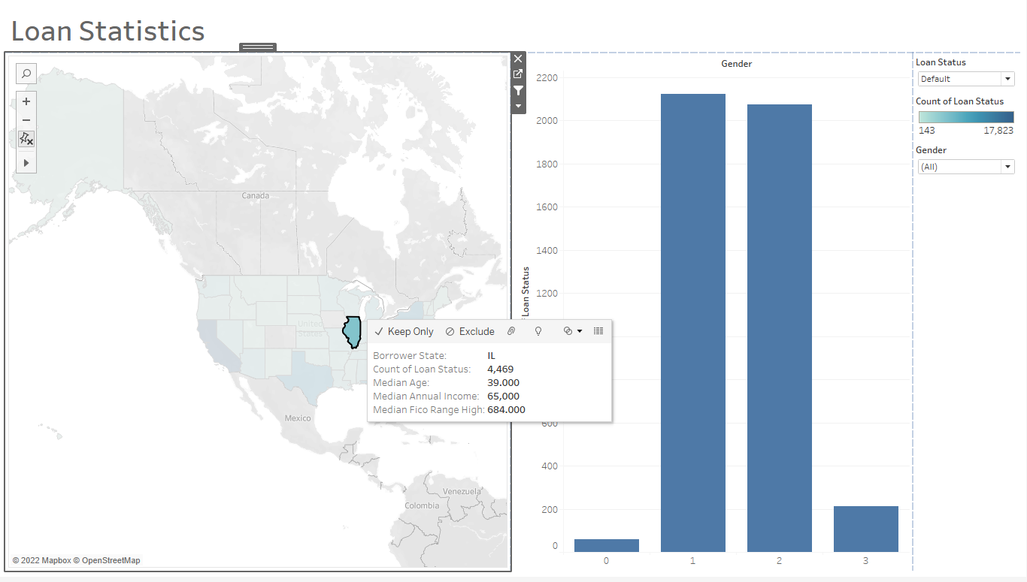
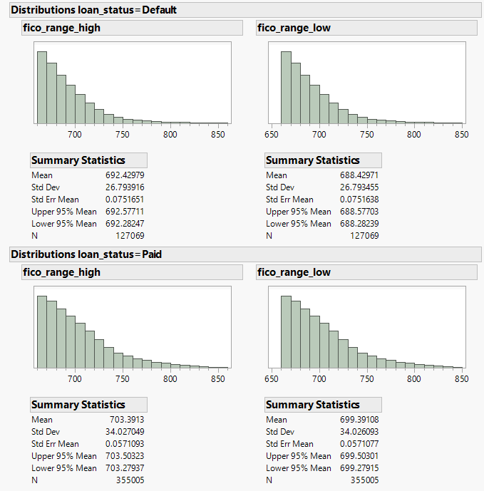
Exploratory Data Analysis
Tableau
JMP

Slide 10
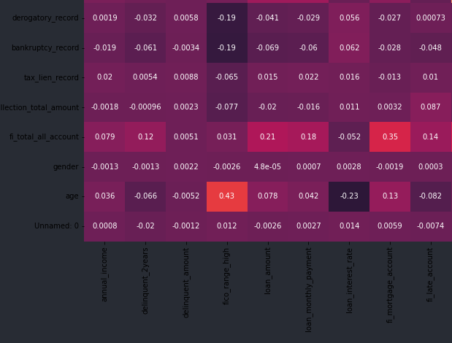
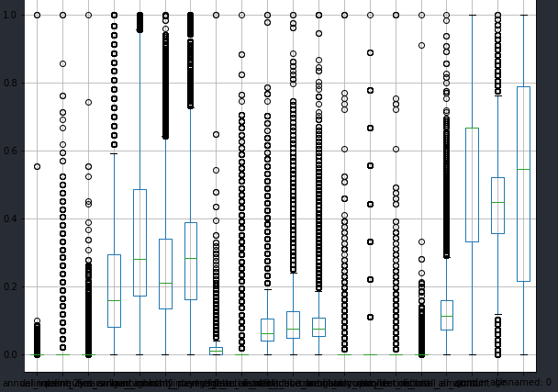
Exploratory Data Analysis (cont.)
Python

Slide 11
Predictive Model

Slide 12
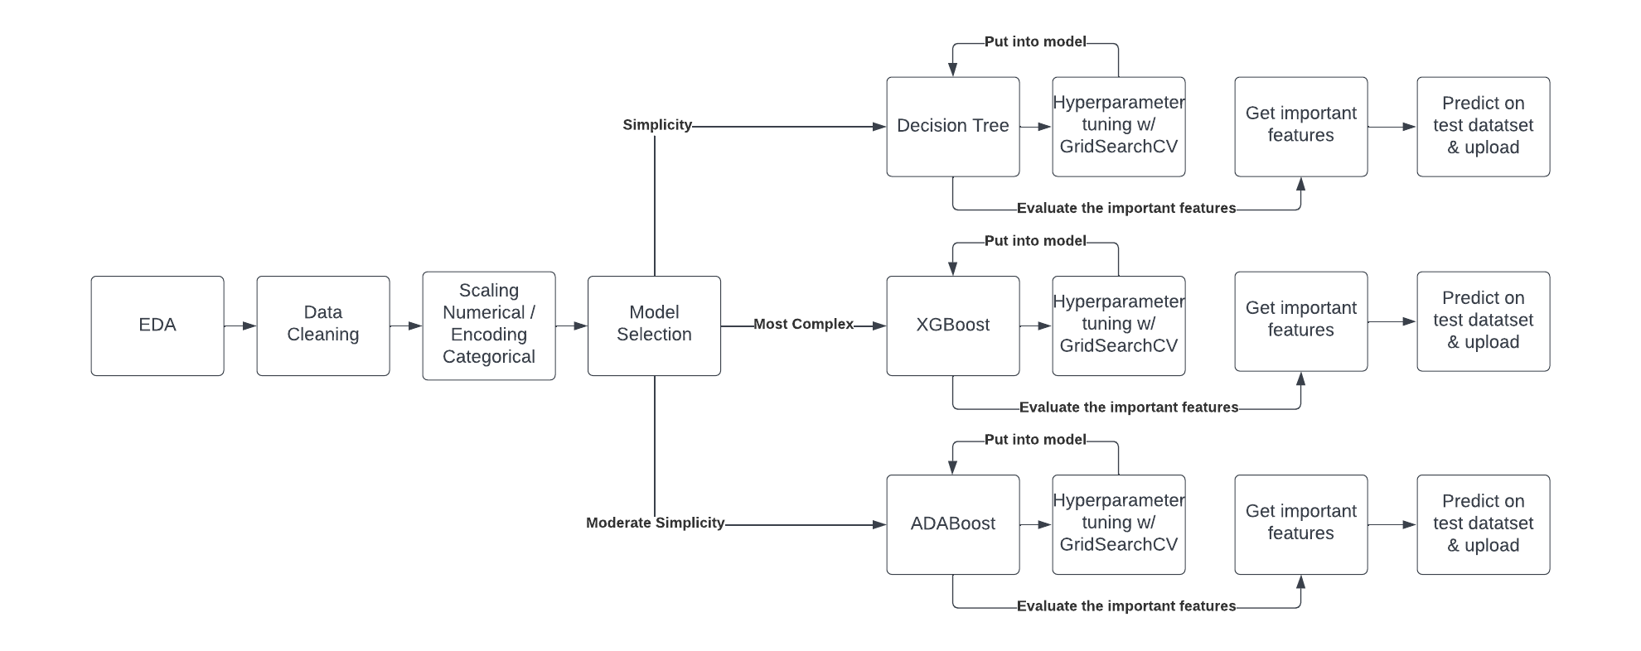
Predictive Model

Slide 13
Predictive Model Selection
Three models were constructed
Decision Tree
Simplicity
AdaBoost
Worked well with unbalanced datasets
XGBoost
A “good at everything” machine learning algorithm

Slide 14
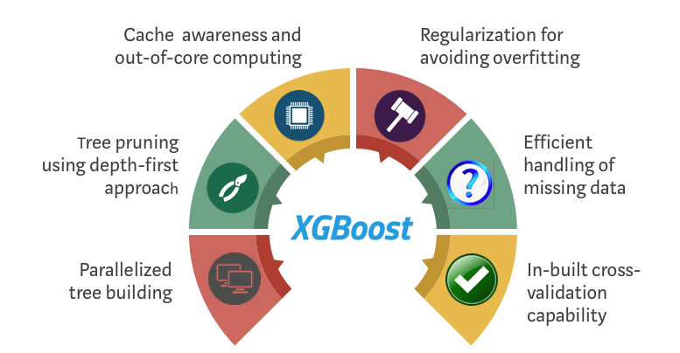
Final Predictive Model Selection
XGBoost
High base F1 score (0.93)
Hyperparameter tuning
“scale_pos_weight”
Industry standard ML model

Slide 15
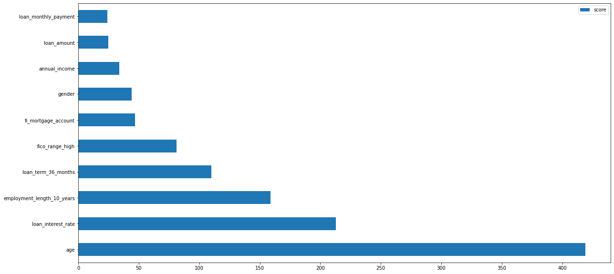
What factors Influenced the Model?

Slide 16
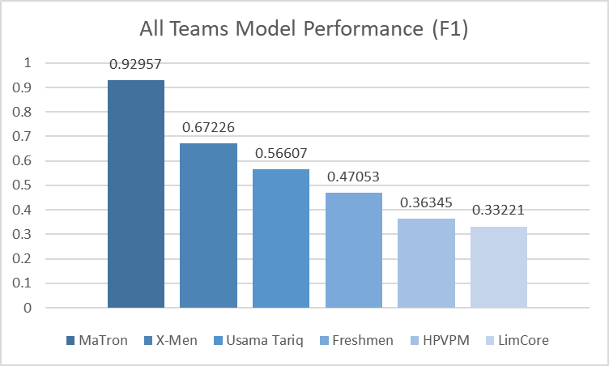
Competition Comparison

Slide 17
Bias

Slide 18
Protected Classes
Regulation of AI and ML Models
Use in employment decisions
Future regulation
Protected Classes
8 major categories
Focus on Age
Source: https://www.eeoc.gov/newsroom/eeoc-launches-initiative-artificial-intelligence-and-algorithmic-fairness#:~:text=%E2%80%9CBias%20in%20employment%20arising%20from,anti%2Ddiscrimination%20laws%20still%20apply.

Slide 19
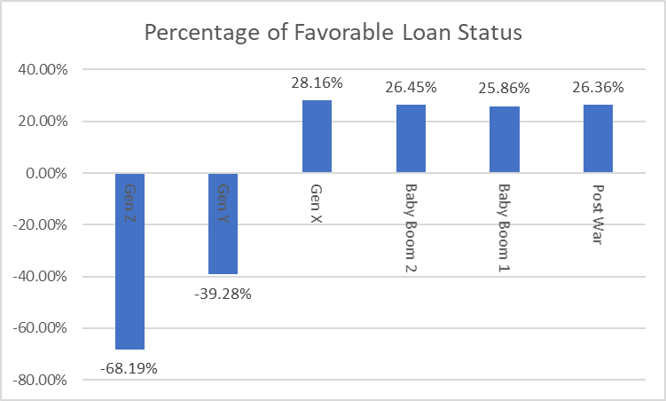
Loan Discrimation based on Age

Slide 20
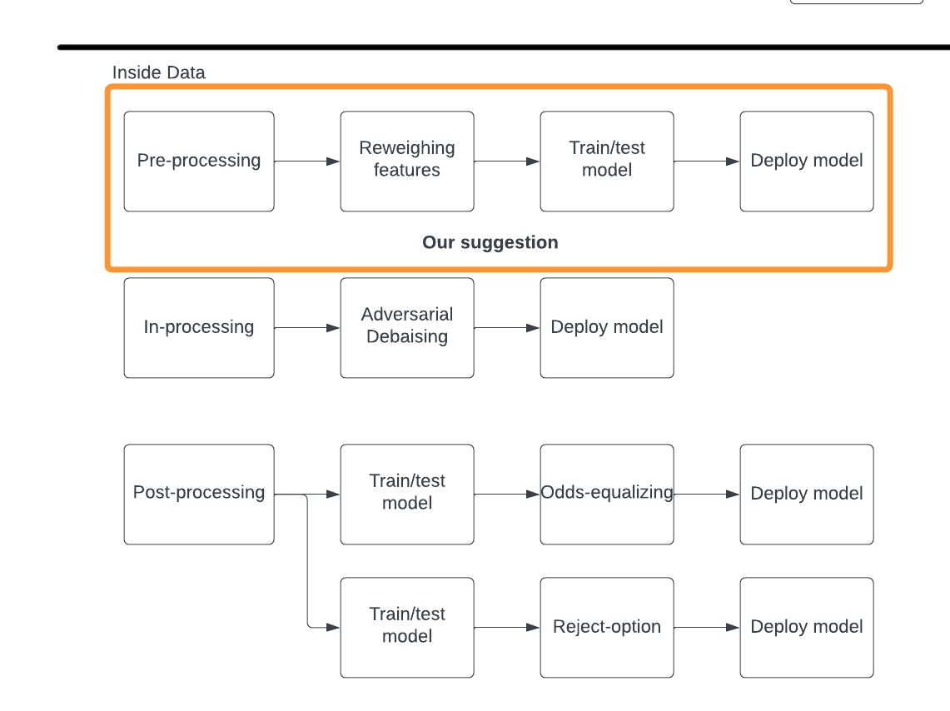
Bias Mitigation Solution
3 Techniques:
Pre-processing
In-processing
Post-processing

Slide 21
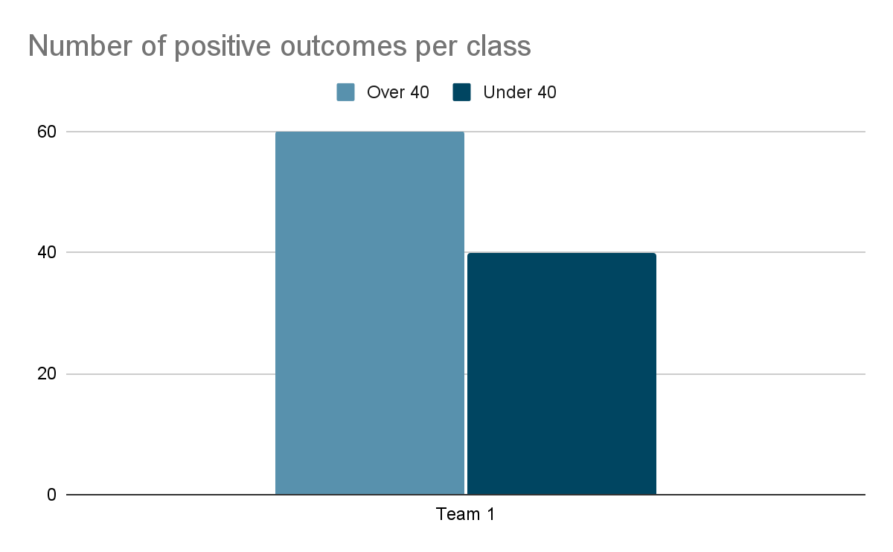
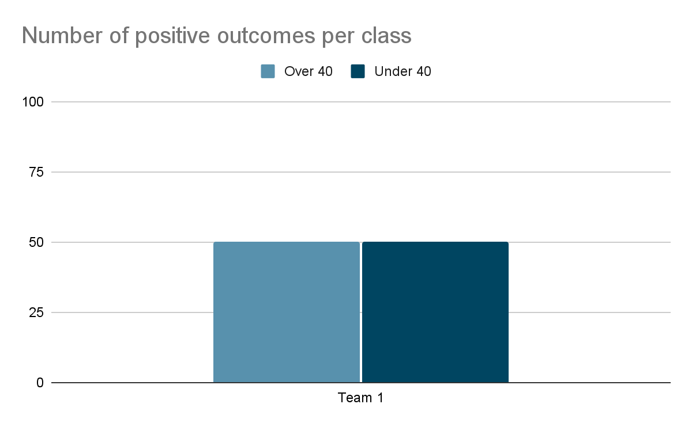
Reweighing Example

Slide 22
Reweighing Effects on Model Performance
Before Reweighing
After Reweighing

Slide 23
Portfolio Performance

Slide 24
Portfolio Performance
A Healthy Portfolio?
High Proportion of Paid Loans
High Loan Profitability Ratio

Slide 25
Is SCB’s Portfolio Healthy?

Slide 26
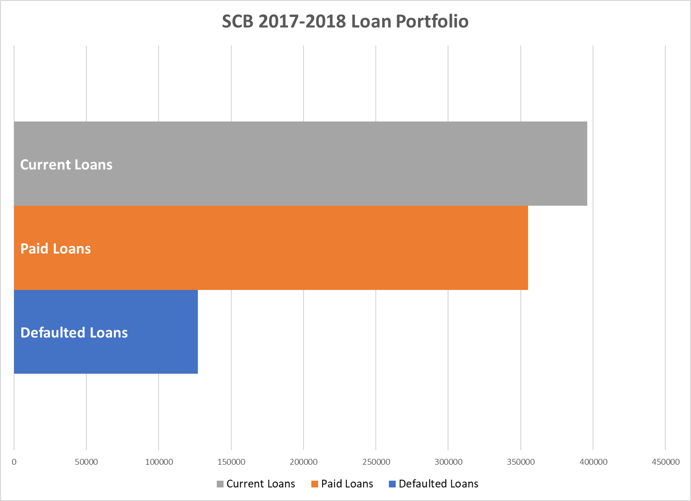
Portfolio Statistics
Notes:
There are 877,986 Loans in SCB’s 2017-2018 Loan Portfolio

Slide 27
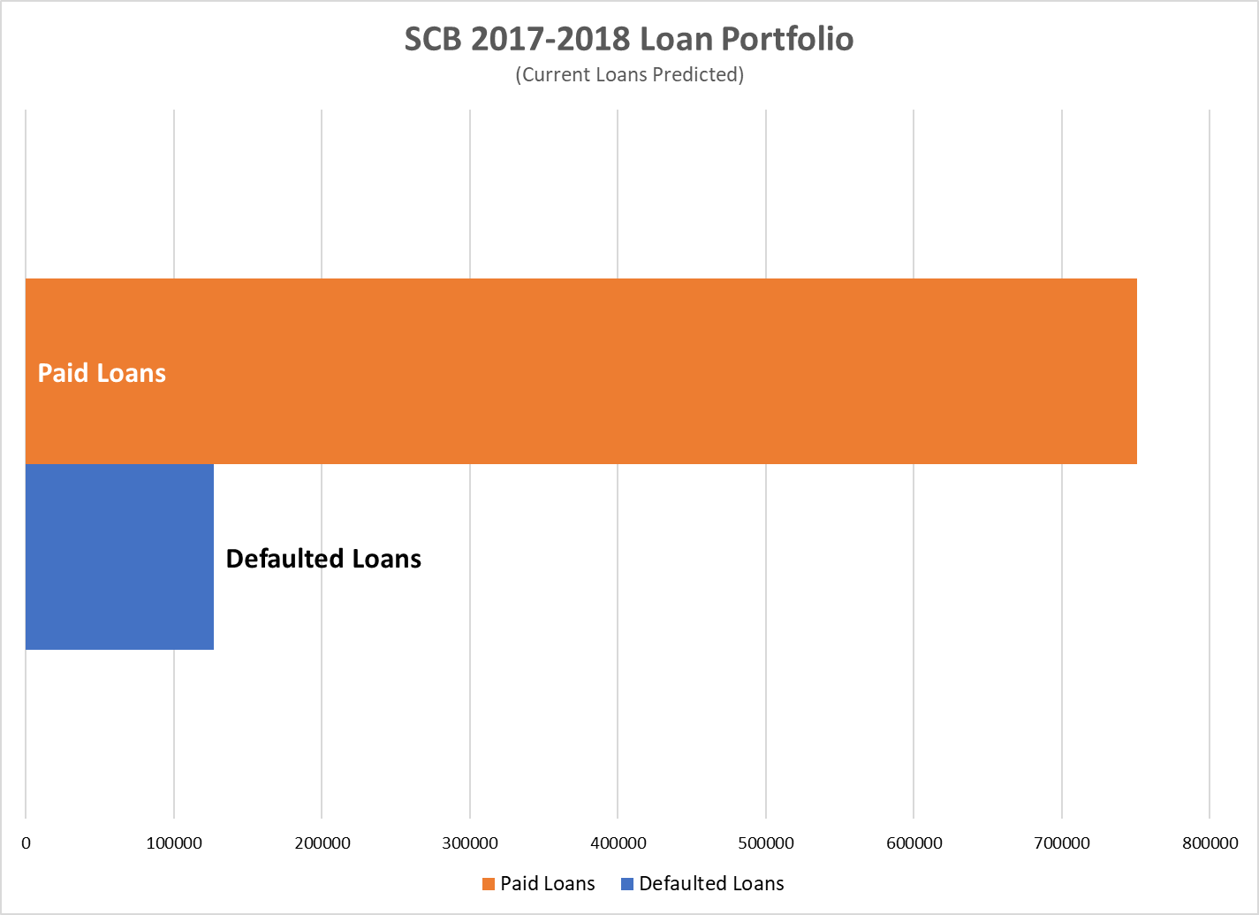
Portfolio Statistics
Notes:
There are 877,986 Loans in SCB’s 2017-2018 Loan Portfolio

Slide 28
Mean Profitability Ratios
Mean Profitability Ratios
Mean of Paid Loans | 1.12
Mean of Defaulted Loans | 0.40
36 Month Loans | 0.46
60 Month Loans | 0.30
Mean of Paid & Defaulted Loans | 0.93
Mean of Current Loans | 0.25
Mean of Current Loans (Predicted) | 1.16

Slide 29
Portfolio Profitability Ratios
Portfolio Profitability Ratios
Paid & Defaulted Loans | 0.91
All Loans (Current Predicted) | 1.10

Slide 30
Factors Affecting Profitability
Paid Loans
Interest Rate
Defaulted Loans
Loan Completion
Interest Rate
Time to Default
Average Months to Default (All) | 15
Average Months to Default (36 Month) | 15
Average Months to Default (60 Month) | 16

Slide 31
Is SCB’s Portfolio Healthy?

Slide 32
Recommendations

Slide 33
Increase Profitability
Ensure Loan Repayment
Avoid high risk borrowers
36 vs 60 Month Loans
Difference in default profitability

Slide 34
Using our Model
Our XGBoost model is an effective prediction tool

Slide 35
Bias Mitigation
Changing Data Collection
Reweighing

Slide 36
Questions?

